Slide 1

Talend ESB
Module Code : ESB05
By : Muhammad Faris Ashim

Slide 2


Talend ESB Administration
Using a Message Broker

Slide 3
ESB messaging
Talend ESB server embeds a message broker called ActiveMQ. This module is message-oriented middleware (MOM).
Its only purpose is to handle messages and make sure they are delivered or broadcasted to their recipients.
ActiveMQ uses standard formats (natively, JMS by default) to make sure messages can be delivered to and understood by any application.
3

Slide 4
ESB messaging, continued
There are two strategies for delivering a message using MOM:
Point-to-point messaging, using queues
Broadcasting, using topics
4

Slide 5
ESB messaging: point-to-point queue
The sender of the message is called a producer.
The producer sends a message to a queue on the MOM. A queue is a destination with a unique name.
The recipient of the message is called a consumer.
The consumer is connected to the MOM and listening to one queue.
When a message is delivered to the queue, the consumer reads it.
5

Slide 6
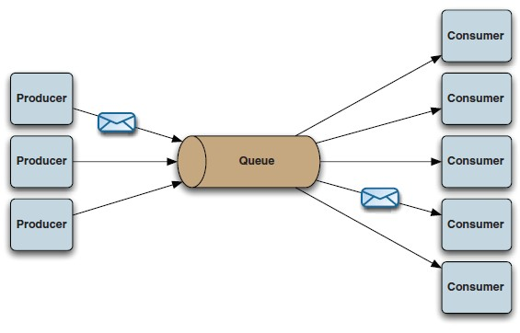
ESB messaging: point-to-point queue, continued
When a consumer has read the message, it is considered consumed and removed from the queue
A message sent on a queue can have only one recipient
6

Slide 7
ESB messaging: broadcast topic
The sender of the message is called a publisher.
The publisher sends a message to a topic on the MOM. A topic is a destination with a unique name.
The recipient of the message is called a subscriber.
Subscribers are connected to the MOM and listening to the topic.
When a message is delivered to the topic, all connected subscribers receive it.
7

Slide 8
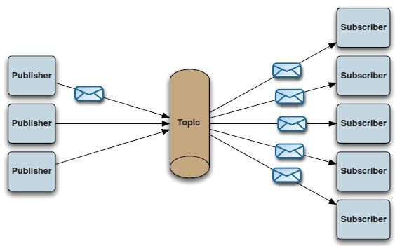
ESB messaging: broadcast topic, continued
When the subscribers receive the message, it is removed from the topic
A message sent on a queue can have as many recipients as there are subscribers
8

Slide 9
JMS components
Talend ESB offers a cJMS component to send messages to or receive messages from a message broker
Like the database connection components in DI Jobs, the ESB palette has a cMOMConnection component that creates a persistent connection to the message broker
9

Slide 10
Lab overview
In this lab, you will:
Connect to the ActiveMQ message broker
Send messages to queues on the message broker using the cJMS component
10

Slide 11
Talend ESB Basics
Calling Data Integration Jobs in Mediation Routes

Slide 12
Calling data integration Jobs
Mediation routes are very good at integrating applications, routing, and delivering messages according to your provided set of rules
However, mediation routes are not made for data transformation or data processing
If you need to transform data, Talend offers the ability to call a DI Job from a route

Slide 13
Call a DI Job from a route
To call a DI Job, use the cTalendJob component
When the message reaches the cTalendJob component, data is transferred to the job and processed. When the job is finished processing data, it returns the data in a message that goes along the route.

Slide 14
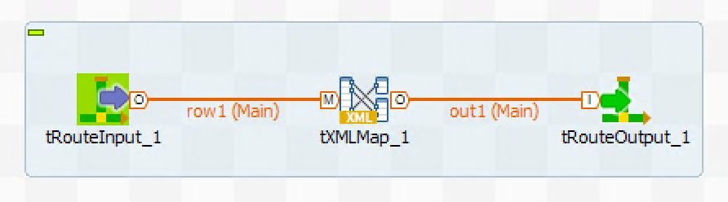
Receive a route message in a DI Job
To enable a DI Job to be used in a route, you need to use
specific components
tRouteInput—this component gets the exchange from the route and can be configured to get the body, headers, and properties in a DI schema
tRouteOuput—this component builds the output message from the DI Job and can send data in the body, properties, or headers

Slide 15
Lab overview
In this lab, you will:
Create a route that calls DI Jobs with the cTalendJob component
Create two DI Jobs that can be called by a route
Distribute messages to be processed by one of the DI Jobs

Slide 16
Thank You

